Slide 1
Lecture 3 Downstream processing of single-cell ATAC-seq Filtering, normalizing and clustering data
Physalia workshop 2021 — Bulk and single-cell ATAC-seq analysis
Instructor: Jacques Serizay
Notes:
Hello everybody and thank you for attending my presentation. I am going to talk about the project I recently started working on in the Spassky and Koszul labs, both located in Paris. This project focuses on the unusual cooption of the mitotic machinery to drive, not cell division but cell differentiation.

Slide 2
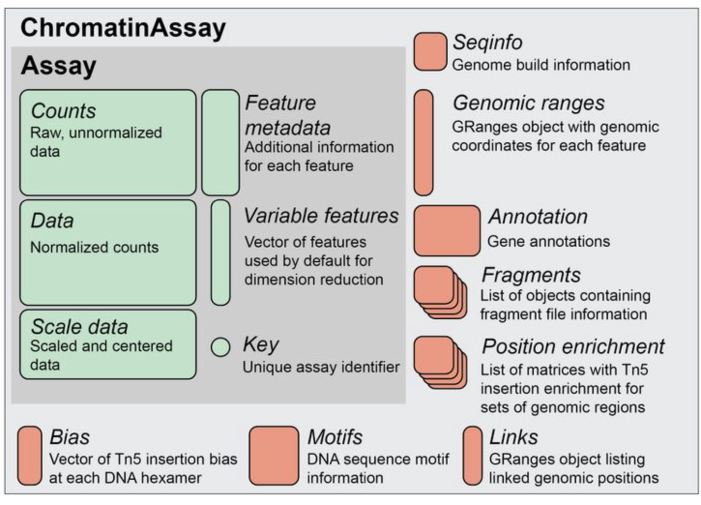
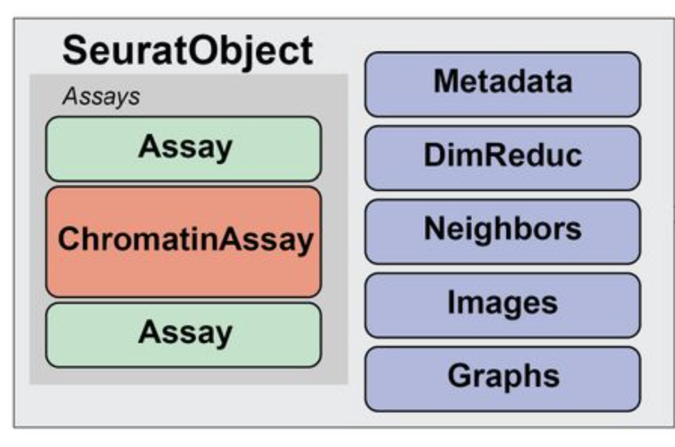
Handling single-cell ATAC-seq data

Slide 3
Creating a Signac object
The workflow is generally the same than for single-cell RNA-seq, when data has been processed with standard 10X Genomics-provided cellranger-count-atac.
counts <- Seurat::Read10X_h5("…*_filtered_peak_bc_matrix.h5")
metadata <- read.table("…*_singlecell.csv")
assay <- Signac::CreateChromatinAssay(
counts = counts,
genome = "…",
fragments = "…"
)
brain <- Seurat::CreateSeuratObject(
counts = assay,
assay = "…",
project = "…",
meta.data = metadata
)

Slide 4
Single-cell ATAC-seq specificities
Single-cell ATAC-seq is extremely sparse, compared to single-cell RNA-seq, for several reasons:
The number of features directly depends on the number of identified open chromatin loci. The more cells, the more features!
The tagmentation reaction does not systematically occur at all open chromatin loci in a cell: there are lots of dropouts!
For each chromatin open locus in a cell, a maximum of 2 tags can be read at best (4, if the DNA is replicated).

Slide 5
Single-cell ATAC-seq data normalization
Because of sparsity, one can simply binarize the data for each chromatin accessible locus.
→ Any locus with > 0 tags is considered “accessible”.
 | cell 1 | cell 2 | cell 3 | cell 4
locus 1 | 1 | 3
locus 2 |  |  | 2
locus 3 |  | 3
 | cell 1 | cell 2 | cell 3 | cell 4
locus 1 | T | T | F | F
locus 2 | F | F | T | F
locus 3 | F | T | F | F

Slide 6
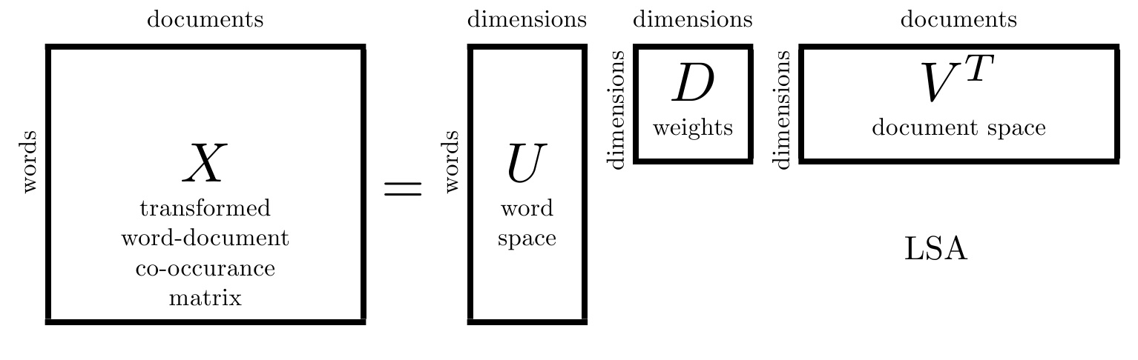
Single-cell ATAC-seq data dimensionality reduction
Again because of sparsity, PCA does not reliably give consistent results.
→ Latent semantic indexing (LSI) seems to be an ideal approach to dimensionality reduction of scATACseq data.

Slide 7
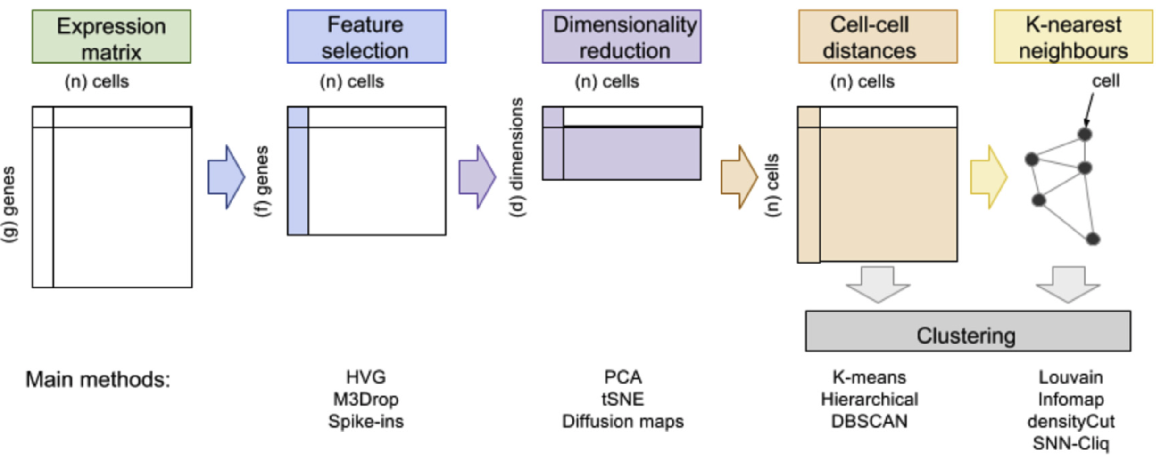
Cell clustering from single-cell ATAC-seq data
Once the data is in a reduced dimensionality, clustering can be performed just like for single-cell RNA-seq, using graph-based methods.
Manual/automated filtering
LSI + SVD
Pearson,
Jaccard,
…
Andrews et al., 2018

Slide 8
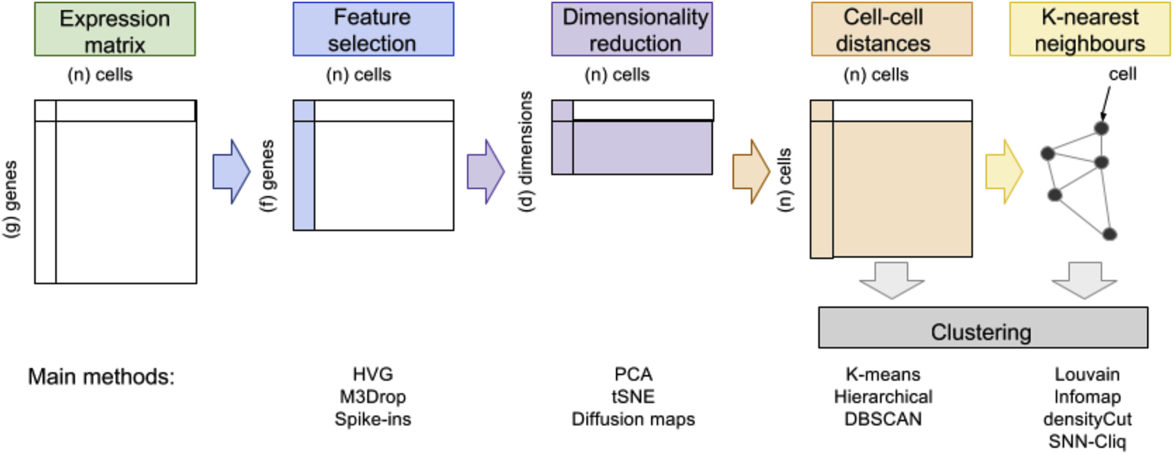

Building a k-Nearest Neighbors graph (with k = 4)
4
1
3
2
4
1
3
2

Slide 9

Building a k-Nearest Neighbors graph (with k = 4)
9
Notes:
I would like to expand these observations to in vivo data. I also want to check what happens in terms of transcriptional dynamics in cells where Cyclin O, a key non-canonical cyclin involved in MCC diff., is knocked-out.

Slide 10
Extending KNN to SNN graphs (Shared Nearest Neighbors) (still with k = 4)
10
Notes:
I would like to expand these observations to in vivo data. I also want to check what happens in terms of transcriptional dynamics in cells where Cyclin O, a key non-canonical cyclin involved in MCC diff., is knocked-out.

Slide 11
Extending KNN to SNN graphs (Shared Nearest Neighbors) (still with k = 4)
Two cells are connected by an edge if any of their nearest neighbors are shared.
11
Notes:
I would like to expand these observations to in vivo data. I also want to check what happens in terms of transcriptional dynamics in cells where Cyclin O, a key non-canonical cyclin involved in MCC diff., is knocked-out.

Slide 12
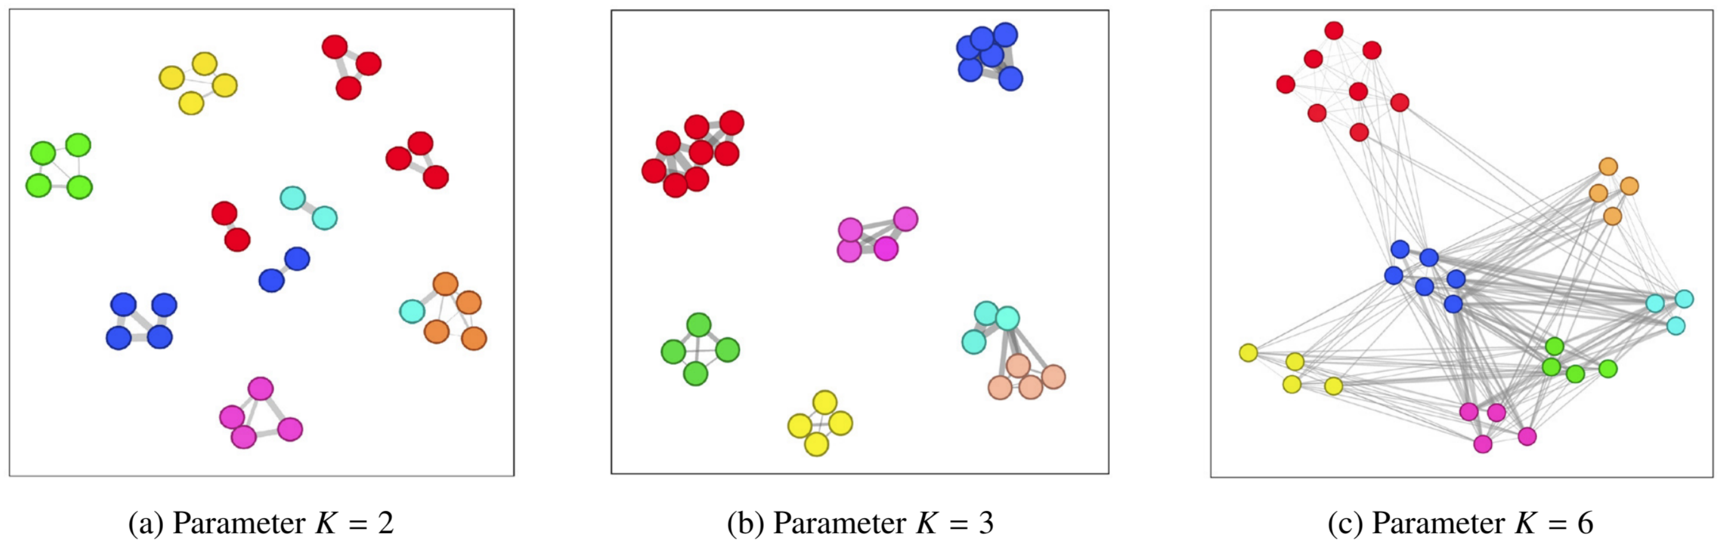
Extending KNN to SNN graphs (Shared Nearest Neighbors) (still with k = 4)
K is important when building KNN / SNN graphs !
12
Notes:
I would like to expand these observations to in vivo data. I also want to check what happens in terms of transcriptional dynamics in cells where Cyclin O, a key non-canonical cyclin involved in MCC diff., is knocked-out.

Slide 13
Graph-based clustering
Graph-based clustering is nothing more than community detection (an “old” field from ’00s).
13
Notes:
I would like to expand these observations to in vivo data. I also want to check what happens in terms of transcriptional dynamics in cells where Cyclin O, a key non-canonical cyclin involved in MCC diff., is knocked-out.

